Slide 1
Introduction
This project demonstrated the power of SQL in transforming cab booking operations data into actionable business insights. From customer behavior to profitability and operational efficiency, each query revealed patterns that help optimize services, improve user satisfaction, and guide data-driven decision-making. Well-structured SQL logic can empower strategic planning and improve real-world business outcomes.

Slide 2
Table of Contents:
Slide 1-2 Introduction and Table of contents
Slide 3 ER Model of the Dataset
Slide 4-9 SQL queries to explore insights
Slide 10 Data schema set up
Slide 11-13 Data insertion

Slide 3
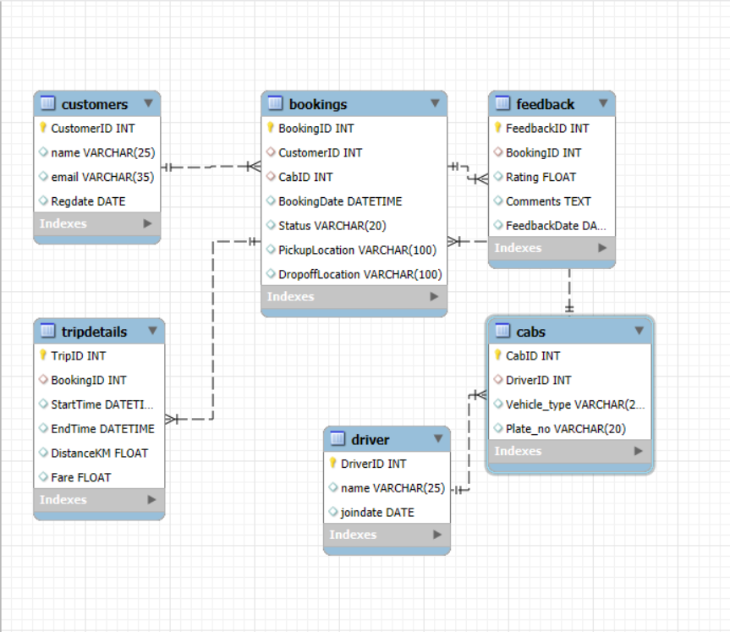
ER Diagram of the Dataset

Slide 4
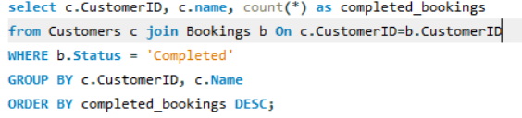
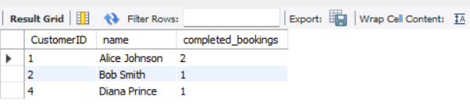
Identify loyal, engaged customers who complete bookings

Slide 5
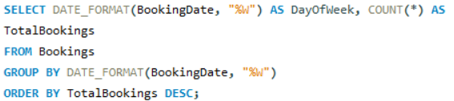
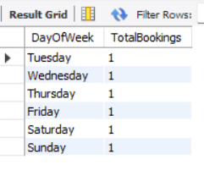
To check busiest day of the week

Slide 6
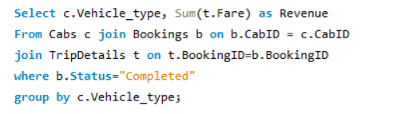

Sedan vs SUV to compare and decide cabs planning based on profitability

Slide 7
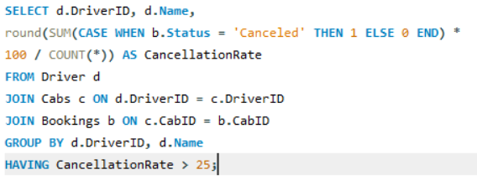

Drivers with High Cancellation Rate (>25%)

Slide 8
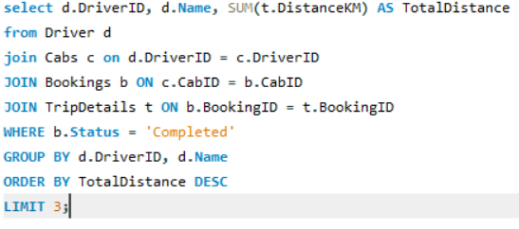

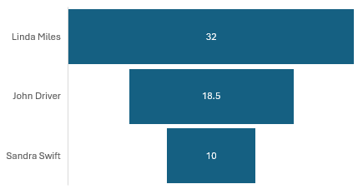
Top 3 Drivers by Total Distance Covered

Slide 9
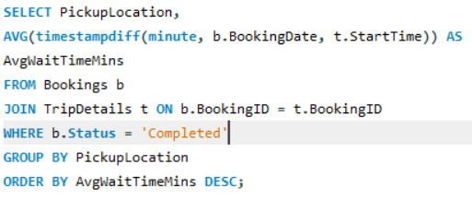
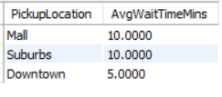
Identify average wait time for locations

Slide 10

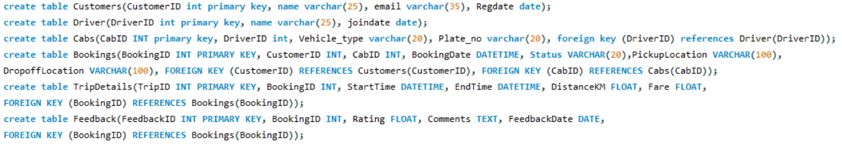
Setting up database schema

Slide 11
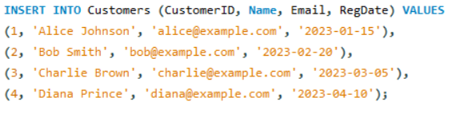
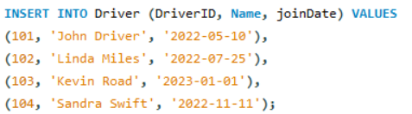
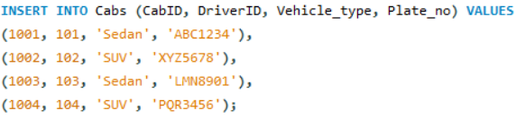
Inserting Data

Slide 12
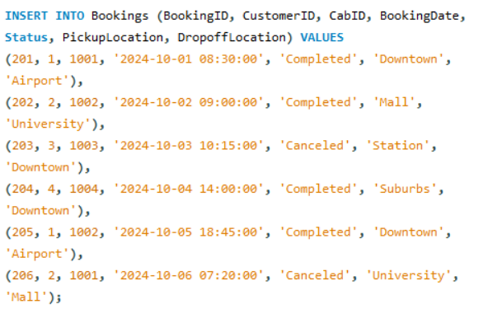
Inserting Data contd…

Slide 13
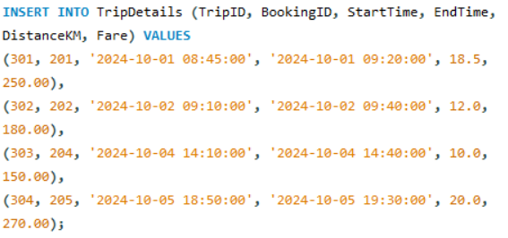
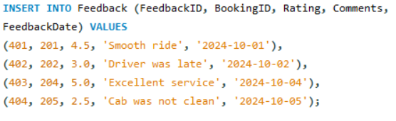
Inserting Data contd…

Slide 14
THANK YOU

